Slide 1


PREDICTING THE MVP IN AN NBA SEASON
Project Team 10

Slide 2

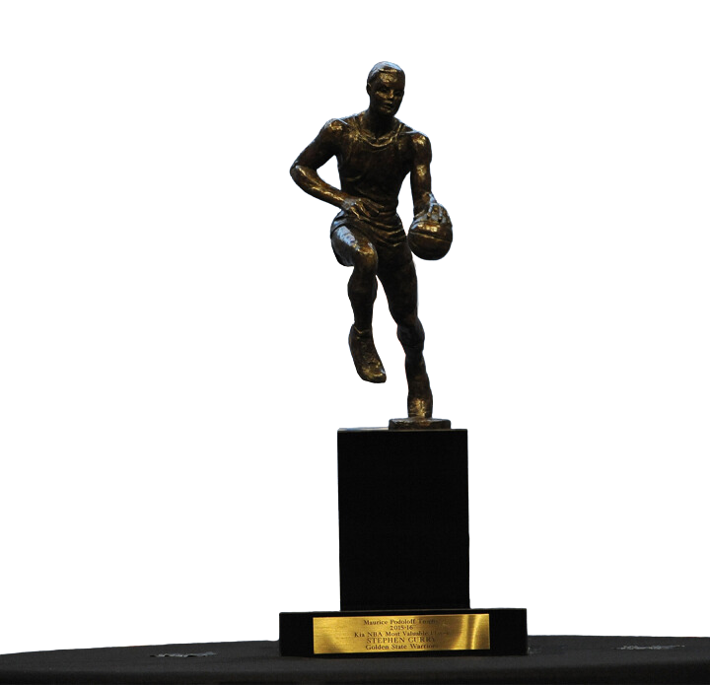
What's The Significance Of An MVP In The NBA?
MVP OR MOST VALUABLE PLAYER IS AN AWARD THAT IS USUALLY GIVEN TO THE MOST IMPACTFUL AND IMPORTANT PLAYER THAT HAS HAD A SIGNIFICANT INFLUENCE ON THEIR TEAM IN THE NBA.

Slide 3

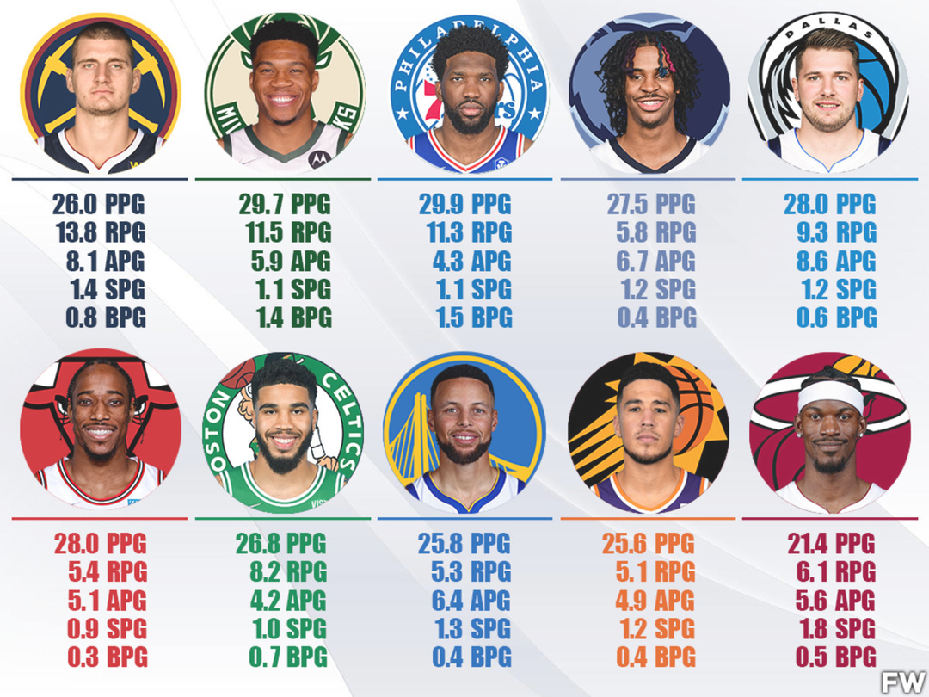
How Does A Player Become An MVP?
NBA MVPs are Currently Awarded On These Protocols:
Vote by panel of sportswriters and broadcasters.
Based on regular season performance. Announced before the playoffs.
Considers individual statistics, team record, leadership, and impact on the game.
Given to player who contributed most to team's success.
Award has been given since 1955-56 season.

Slide 4
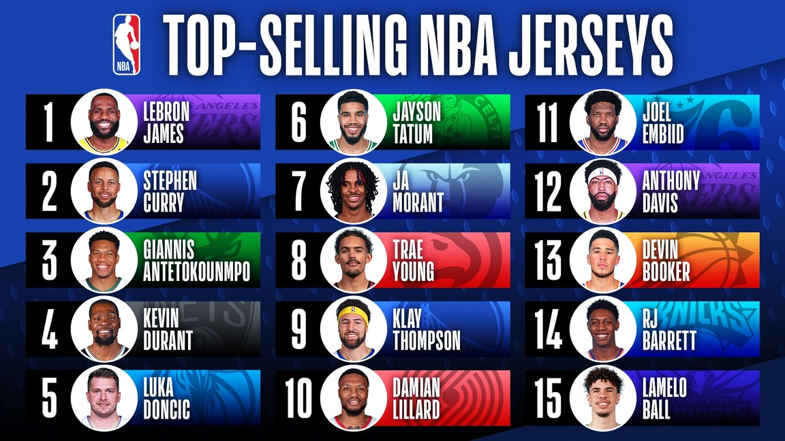

Why Do We Need To Predict The Most Likely MVP?
As a Business, NBA Teams have the aim of maximizing their revenue in addition to winning the NBA. Having a Player that has increased chances of winning the MVP means
Recruiting: Teams want to attract top talent, and being able to showcase past MVPs is a strong selling point for attracting free agents and drafting new players.
Contracts: MVPs are often rewarded with lucrative contracts, and accurately predicting the MVP can help teams plan and budget for their future.
Fan Engagement: MVP predictions generate buzz and excitement among fans, which can increase ticket sales, merchandise sales, and TV ratings.
Strategy: Predicting the MVP can also inform a team's game strategy and help them prepare for specific opponents and players.

Slide 5
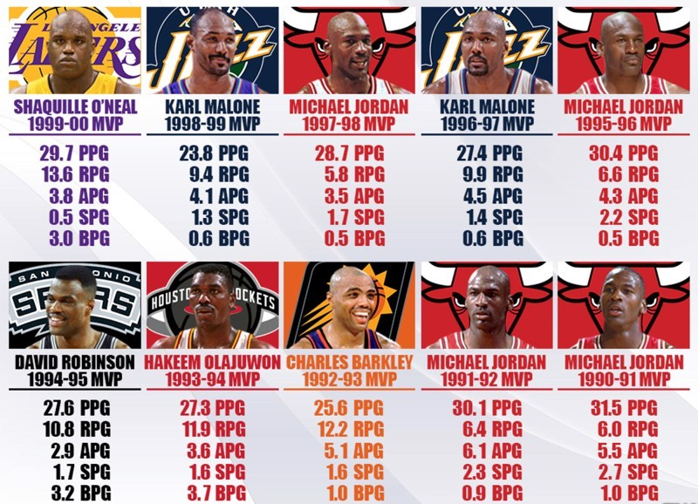
Predicting The Most Likely Candidates To Win The NBA MVP
WE PROPOSED THE FOLLOWING
Use A Dataset that contains historical data of important statistics that contribute to the selection of an MVP
Clean and Wrangle The Data to Identify The Most Stand-Out Players' Statistics and Create A Separate Historic Dataset, isolating 10 Statistically Best Players Define The Target Value as Total Vote Share for each Individual Contender
Define The Features (Most Significant Stats) Build Models and Check Accuracy
Visualize The Results Detect The Most Likely MVP

Slide 6

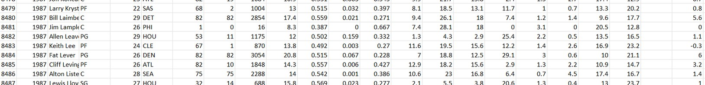
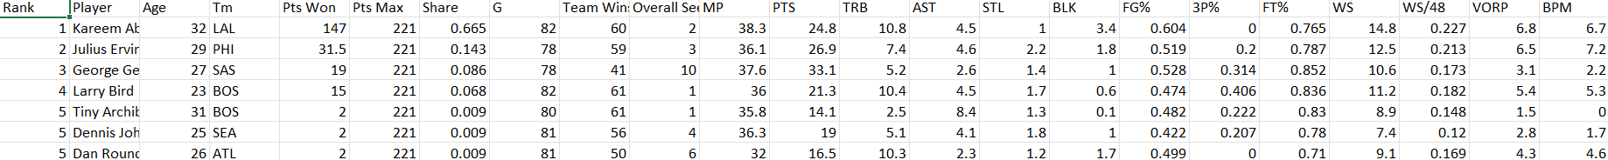
A Brief Description About The Dataset
WE USED THE FOLLOWING DATASETS. THERE WERE 3 MORE DATASETS WE USED FOR REFERENCE WHICH WERE TAKEN FROM NBA STUFFER, DRIBBLE ANALYTICS AND STATHEAD.COM
The Dataset contains All Player Statistics for Each and Every Player That has Played The NBA Since 1950.
Source : Basketball-Reference.com
The Dataset contains key statistics for the 10 best performing players in each NBA season since 1970.
Source : Kaggle.com

Slide 7

Exploratory Analysis
THE DATASET WE USED AFTER BEING CLEANED, IDENTIFIED THE FOLLOWING FEATURES AS KEY
Games Played
Team Wins
Overall Seed (Team Position In Standings) MP (Minutes Played)
PTS/G (Points/Game)
TRB/G (Total Rebounds/Game) AST/G (Assists/Game)
STL/G (Steals/Game) BLK/G (Block/Game) FG% (Field Goal %) 3P% (3 Point %)
FT% (Free Throw %) WS (Win Shares)
WS/48 (Win Shares/48 Mins) BPM (Box Plus/Minus)
VORP (Value Over Replacement)
GP TW OS MP PTS/G TRB/G AST/G STL/G BLK/G
FG% 3P% FT%
WS WS48 BPM VORP
100%
100%
100%
100%
100%
100%
100%
100%
100%
100%
100%
100%
100%
100%
100%
100%

Slide 8


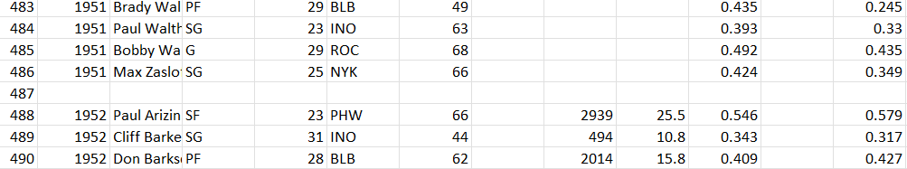
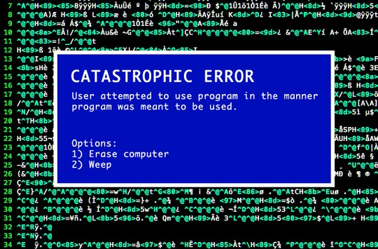

Cleaning The Dataset
We cleaned 388 Null Values From The Dataset
The Rest Of The Dataset which contained values from 1950-1979 were eliminated due to inconsistencies and missing values
Us When we found a dataset with minimal cleaning requirements
The Dataset We Finally Extracted In Order to Fit the Model was The Top 10 Player Statistics from the years 1980-2020

Slide 9
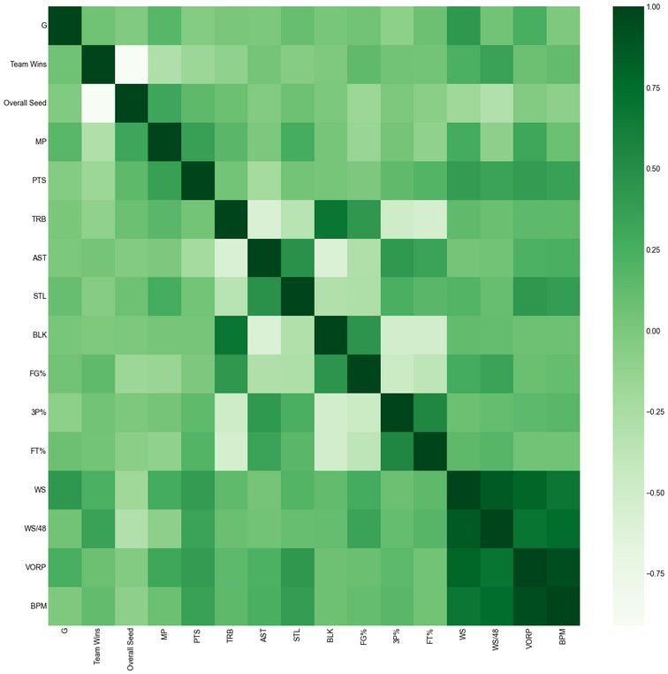
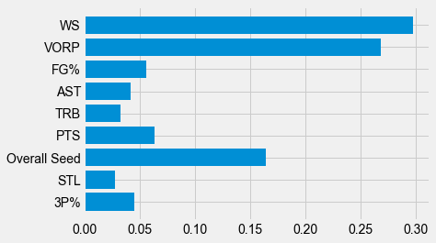
Important Variables That Determine The MVP
The Correlation Matrix The Most Important Features
It is noticeable that there exists a significant association between WS and WS/48, as well as BPM and VORP. This is not surprising given that the metrics WS/48 and VORP rely on WS and BPM, respectively.

Slide 10

RMSE Scores of the models
Models | RMSE
Linear Regression | 0.4
Random Forest | 0.3
KNN | 0.3

Slide 11

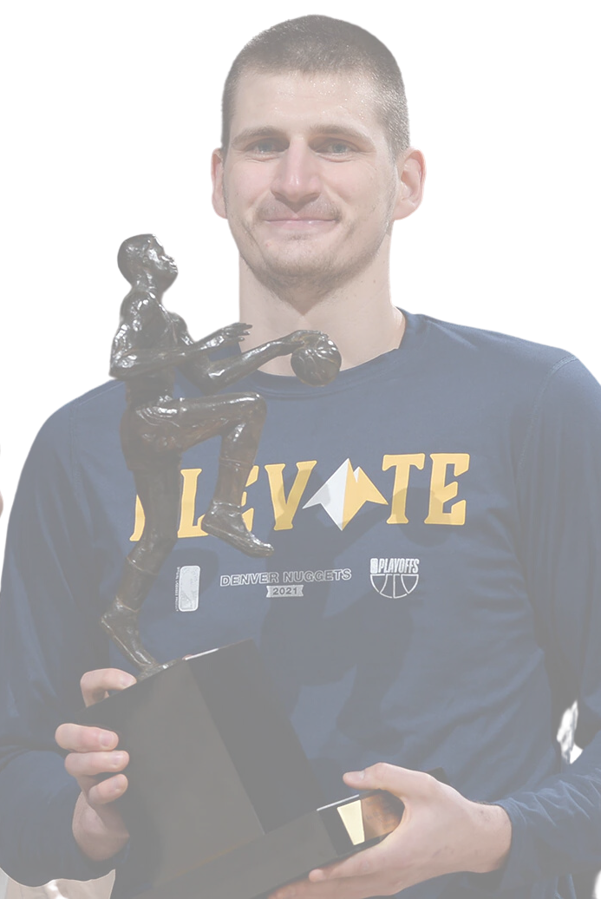
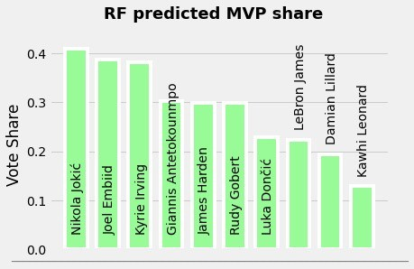
The Prediction
AS PER OUR MODEL'S PREDICTION, NIKOLA JOKIC WAS PREDICTED TO BE THE MOST LIKELY TO WIN THE NBA MVP AWARD
Nikola Jovic, Denver Nuggets

Slide 12
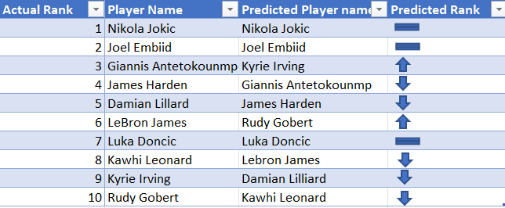
Actual Result vs Prediction for MVP

Slide 13
Trying Predictions for the 2019- 2020 Season

Slide 14

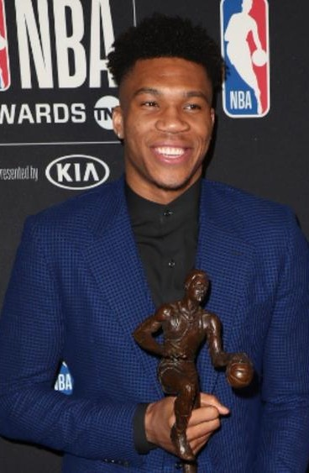
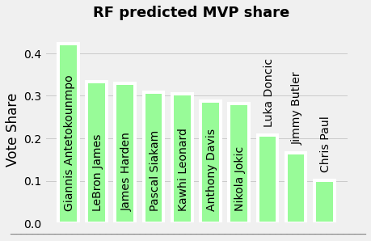
The Prediction -2020
AS PER OUR MODEL'S PREDICTION, GIANNIS ANTETOKOUNMPOWAS PREDICTED TO BE THE MOST LIKELY TO WIN THE NBA MVP AWARD
Giannis Antetokounmpo

Slide 15
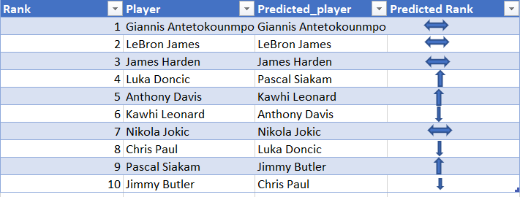
Actual Result vs Prediction for MVP

Slide 16

Thank You
Presented By Aditya Deshpande
Abhishek Devangana Akhil Khajuria Siddhant Ambardekar Jude Lobo

